Slide 1


QCrypt
Classical & Quantum Cryptography Engine
OOP C++ PROJECT
QCrypt is a C++ object‑oriented engine combining five classical cipher implementations with a BB84 quantum key distribution layer. Designed for modularity, testability and educational clarity in an undergraduate OOP context.
Name: M.AbuBakar · Roll No: BSCS25109 · Course: Object Oriented Programming
Notes:
• Welcome everyone. Today I'm presenting QCrypt, a Classical and Quantum Cryptography Engine. • This is an Object-Oriented C++ project I've developed for my Object Oriented Programming course. • QCrypt combines two main components: Five classical cipher implementations (traditional encryption methods) A BB84 quantum key distribution layer (a quantum cryptography protocol) • The engine is built with three key principles in mind: Modularity: Each component is independent and reusable Testability: Designed to be thoroughly tested and verified Educational clarity: Clear structure for learning OOP concepts • This project demonstrates practical application of OOP principles like inheritance, polymorphism, and encapsulation in a real cryptography context.

Slide 2

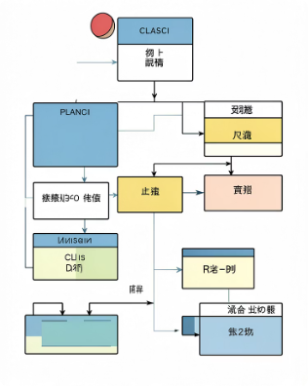

Project Overview
QCrypt is an OOP C++ engine that implements five classical ciphers and a BB84 quantum protocol as modular components. The system is packaged as a set of reusable classes: cipher primitives, a crypto manager, math utilities and a simulated quantum channel for teaching QKD concepts and eavesdrop detection.
6 Cipher Algorithms
OOP Architecture
Quantum Layer
22 classes total, 7 abstract bases. Testable components.
BB84 QKD simulation with basis sampling, public reconciliation, and eavesdrop detection via error-rate monitoring.
Caesar · ROT13 · Vigenère · XOR · RSA · BB84
Notes:
• QCrypt is a C++ engine built with object-oriented design principles • Implements six cipher algorithms total: Caesar, ROT13, Vigenère, XOR, RSA, and BB84 • All components are modular and reusable classes Architecture highlights: • 22 classes organized with 7 abstract base classes • Maximum inheritance depth of 3 levels—keeps it clean and maintainable • Follows Single Responsibility Principle, making each component testable and focused Three main layers: Cipher primitives – the six classical and quantum algorithms Crypto manager – orchestrates cipher operations Math utilities & quantum channel – supports calculations and QKD simulation Quantum component: • BB84 quantum key distribution protocol fully simulated • Demonstrates basis sampling and public reconciliation • Built-in eavesdrop detection through error-rate monitoring • Perfect for teaching quantum cryptography concepts The whole system is designed as a teaching tool—students can see classical cryptography, understand quantum principles, and observe security vulnerabilities in action.

Slide 3

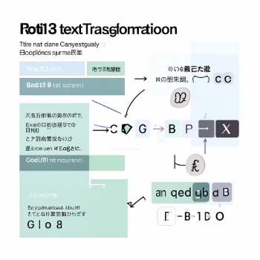
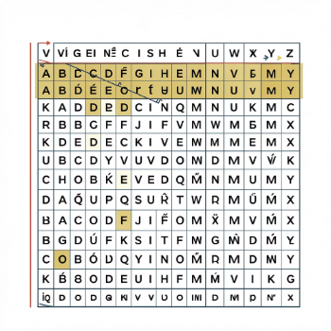
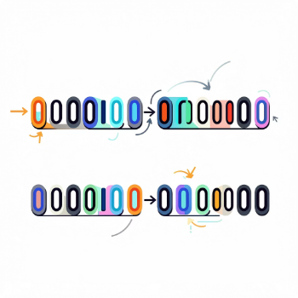
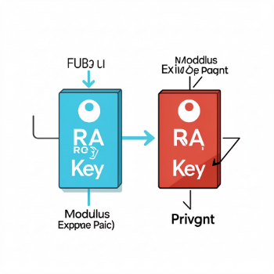

Cipher Algorithms
Caesar
ROT13
Vigenère
XOR
Type: Substitution · Key: shift = 7 · Formula: C = (M + key) mod 26
Type: Substitution · Key: shift = 13 · Formula: Self‑inverse: encode = decode
Type: Polyalphabetic · Key: keyword · Formula: C = (M + Kᵢ) mod 26 per character
Type: Bitwise · Key: byte key · Formula: C = M XOR k (self‑inverse)
RSA
BB84
Type: Asymmetric · Key: (e, d, n) · Formula: C = Mᵉ mod n
Type: Quantum QKD · Key: photon polarization · Note: Heisenberg uncertainty underpins measurement disturbance + XOR for symmetric encryption step.

Slide 4
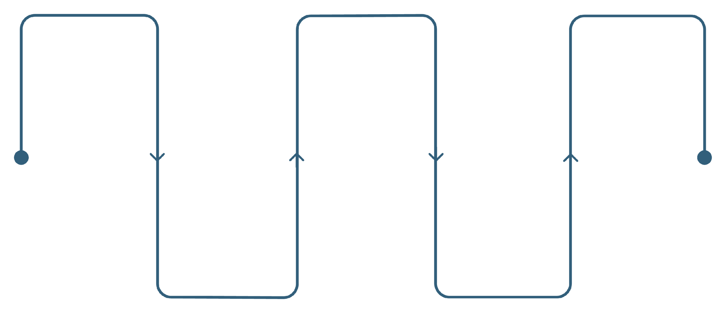
BB84 — Quantum Key Distribution
Heisenberg Uncertainty Principle: measurement in the wrong basis perturbs quantum states and reveals eavesdropping.
Alice Sends
Compare Bases
Use Key
Random bits encoded in random bases
Shared key used for XOR encryption
Keep bits where bases match
Bob Measures
Error Check
Use random bases for each photon
Estimate error rate; abort if >20%
Steps 1–6 are the QKD exchange and verification. Step 7 (mint highlight) applies the derived shared key for symmetric XOR encryption of classical payloads.

Slide 5
OOP Concepts Implemented
🧬 Inheritance
🔒 Encapsulation
Single: Caesar → SubstitutionCipher. Multi‑level: BB84 → QuantumCipher → Cipher. Hierarchical reuse: Caesar & ROT13 inherit SubstitutionCipher.
Keys and internal state are private/protected. Public APIs expose only necessary operations; CryptoManager interacts through narrow interfaces.
🔄 Polymorphism
🏗️ Abstraction
Pure virtual encrypt/decrypt/showInfo methods; runtime dispatch via Cipher* pointers. Virtual destructors ensure safe cleanup.
Seven abstract base classes (Cipher, MathEngine, KeyGenerator, Basis, QuantumChannel, Party, CryptoManager) define contracts as pure virtual interfaces.

Slide 6
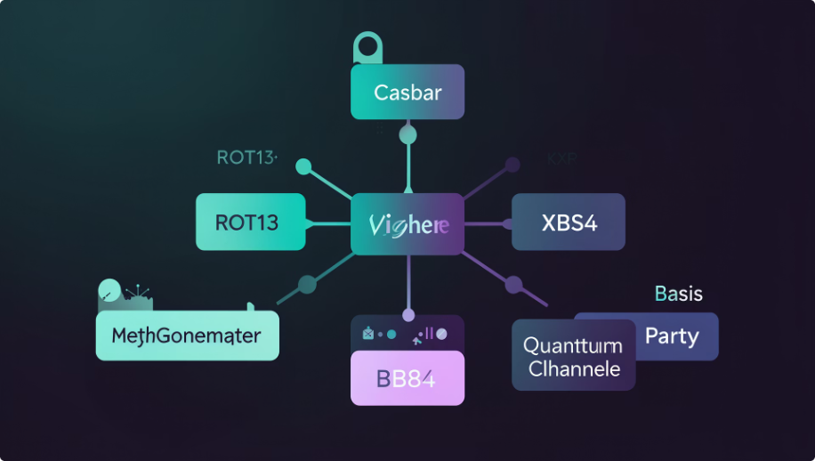

Class Hierarchy & Project Summary
Cipher
├─ SubstitutionCipher
│ ├─ Caesar
│ └─ ROT13
├─ PolyalphabeticCipher
│ └─ Vigenère
├─ BitwiseCipher
│ └─ XOR
├─ AsymmetricCipher
│ └─ RSA
└─ QuantumCipher
└─ BB84
MathEngine
KeyGenerator
Basis
QuantumChannel
Party
CryptoManager — Runtime Polymorphism in Action
CryptoManager demonstrates runtime dispatch: it holds Cipher* references, performs encryption/decryption without compile‑time coupling, and orchestrates BB84 when required.
22
7
Total Classes
Abstract Classes
6
Cipher Algorithms

